Slide 1



Introduction to MATLAB Programming
Lecture 1
Dr. Mrittunjoy Guha Majumdar
UPES Dehradun

Slide 2
Course Objectives
To help the students learn basic operations of the MATLAB language.
To enable the students work with arrays, build scripts, functions and plotting commands.
To make the students develop their own programs using MATLAB language.
To enable the students to perform symbolic computations.
Course Outcomes
On completion of this course, the students will be able to
CO1. Discuss MATLAB working environment, arithmetic operations, variables and operations on arrays.
CO2. Develop MATLAB scripts and functions using the elements of MATLAB programming.
CO3. Demonstrate curve fitting, 2D and 3D visualizations using MATLAB.
CO4. Compare numerical and symbolic computations.
MGM
Dr. Mrittunjoy
Guha Majumdar

Slide 3

About Lecturer: Dr. Mrittunjoy Guha Majumdar
Assistant Professor (Selection Grade), School of Computing Sciences (SoCS) and School of Engineering (SoE), UPES Dehradun
Technical Lead, Center for Excellence in Quantum Technology, UPES Dehradun
Doctorate from Cavendish Laboratory, University of Cambridge in Quantum Information Processing in 2019
Postdoctoral Fellow at Harvard University, Indian Institute of Science (IISc) and Tata Institute of Fundamental Research (TIFR)
Certification in Artificial Intelligence and Machine Learning from the MIT Stephen A. Schwarzman College of Computing, Massachusetts Institute of Technology (MIT)
MGM
Dr. Mrittunjoy
Guha Majumdar

Slide 4
About MATLAB
MATLAB stands for “MATrix LABoratory”
It is a proprietary multi-paradigm programming language and numeric computing environment developed by MathWorks.
MATLAB integrates computation, visualization, and programming in an easy-to-use environment where problems and solutions are expressed in familiar mathematical notation.
Matrix operations, function and data visualization, algorithm implementation, user interface design, and language interface programming are all possible with MATLAB.
MATLAB is an interactive system whose basic data element is an array that does not require dimensioning. This allows you to solve many technical computing problems, especially those with matrix and vector formulations, in a fraction of the time it would take to write a program in a scalar no interactive language such as C or Fortran.
MATLAB is intended primarily for numeric computing, but with additional toolboxes, other capabilities can be harnessed
An optional toolbox uses the MuPAD symbolic engine allowing access to symbolic computing abilities.
An additional package, Simulink, adds graphical multi-domain simulation and model-based design for dynamic and embedded systems.
MGM
Dr. Mrittunjoy
Guha Majumdar

Slide 5
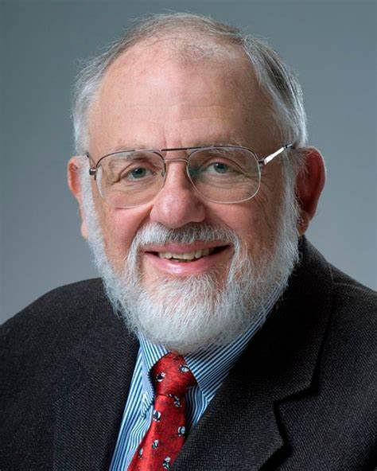
Origins of MATLAB
MATLAB was created by mathematician and computer programmer Cleve Moler, based on his 1960s PhD thesis.
Moler started developing MATLAB for his students at the University of New Mexico as a hobby, initially focusing on linear algebra programming in 1967.
Before version 1.0, MATLAB was a simple interactive matrix calculator without programming capabilities, toolboxes, or graphics.
The first early version of MATLAB was completed in the late 1970s and was publicly disclosed in February 1979 at the Naval Postgraduate School.
Early versions had 71 pre-built functions and were distributed for free to universities, gaining popularity in math departments.
In the 1980s, Cleve Moler teamed up with John N. Little, reprogramming MATLAB in C and marketing it for IBM desktops.
MATLAB became a commercial product in 1984, with MathWorks, Inc. founded to develop the software and the MATLAB programming language released.
MGM
Dr. Mrittunjoy
Guha Majumdar

Slide 6
Origins of MATLAB
The first commercial sale was in 1985 to Nick Trefethen from MIT.
MATLAB gained popularity in academia, and toolboxes created by experts in various fields contributed to its success.
The software was rewritten for different operating systems, with Version 3 released in 1987.
The first MATLAB compiler was developed in the 1990s by Stephen C. Johnson.
In 2000, MathWorks added a Fortran-based library for linear algebra, replacing original LINPACK and EISPACK subroutines.
MATLAB's Parallel Computing Toolbox was introduced in 2004, and GPU support was added in 2010.
Version 8 in 2012 brought significant changes, including a revamped user interface and expanded Simulink functionality.
By 2016, MATLAB introduced technical and user interface improvements, including the MATLAB Live Editor notebook.
MGM
Dr. Mrittunjoy
Guha Majumdar

Slide 7
Installing MATLAB
You can download and install MATLAB, Simulink, and other MathWorks products on Windows®, Mac, and Linux® platforms.
To get started, create a MathWorks Account with your UPES email address.
Sign in and select your products from the MathWorks Downloads page.
Follow the prompts to install the products for which you are licensed.
or
Open MATLAB Online at https://matlab.mathworks.com
MGM
Dr. Mrittunjoy
Guha Majumdar

Slide 8
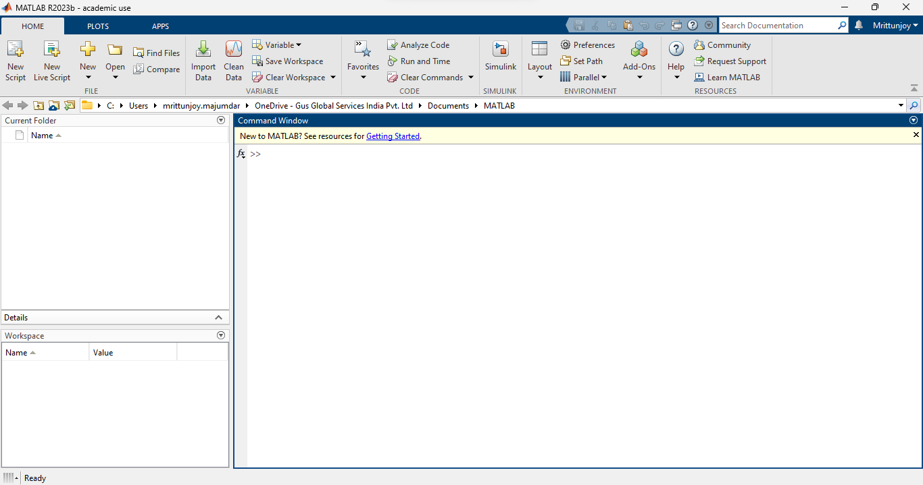
Command Window
MGM
Dr. Mrittunjoy
Guha Majumdar

Slide 9
Workspace Window
MGM
Dr. Mrittunjoy
Guha Majumdar

Slide 10
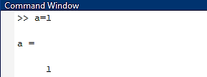

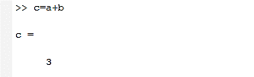
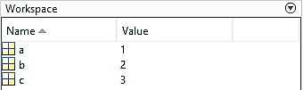

Starting with MATLAB
As you work in MATLAB, you issue commands that create variables and call functions. For example, create a variable named $a$ by typing this statement at the command line:
One can initiate another variable, say $b = 2$, and undertake an operation $c = a + b$:
You can recall a previously defined variable by typing the variable in the command window and pressing $↑$
MGM
Dr. Mrittunjoy
Guha Majumdar

Slide 11

Order of Precedence
The precedence rules for MATLAB operators are shown in this list, ordered from highest precedence level to lowest precedence level:
Parentheses ()
Transpose (.'), power (.^), complex conjugate transpose ('), matrix power (^)
Power with unary minus (.^-), unary plus (.^+), or logical negation (.^~) as well as matrix power with unary minus (^-), unary plus (^+), or logical negation (^~).
Unary plus (+), unary minus (-), logical negation (~)
Multiplication (.*), right division (./), left division (.\), matrix multiplication (*), matrix right division (/), matrix left division (\)
Addition (+), subtraction (-)
Colon operator (:)
Less than (<), less than or equal to (<=), greater than (>), greater than or equal to (>=), equal to (==), not equal to (~=)
Element-wise AND (&)
Element-wise OR (|)
Short-circuit AND (&&)
Short-circuit OR (||)
Illustrative Example:
MGM
Dr. Mrittunjoy
Guha Majumdar

Slide 12
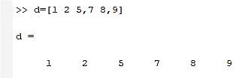
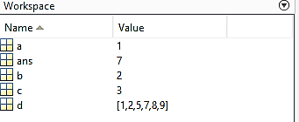
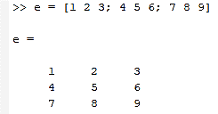
Arrays and Matrices
All MATLAB variables are multidimensional arrays, no matter what type of data.
To create an array with six elements in a single row, separate the elements with either a comma (,) or a space or both.
To create a matrix that has multiple rows, we separate the rows with semicolons.
MGM
Dr. Mrittunjoy
Guha Majumdar

Slide 13
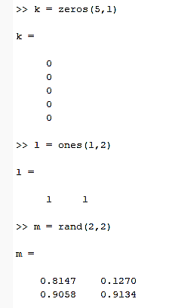
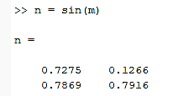
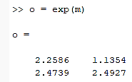
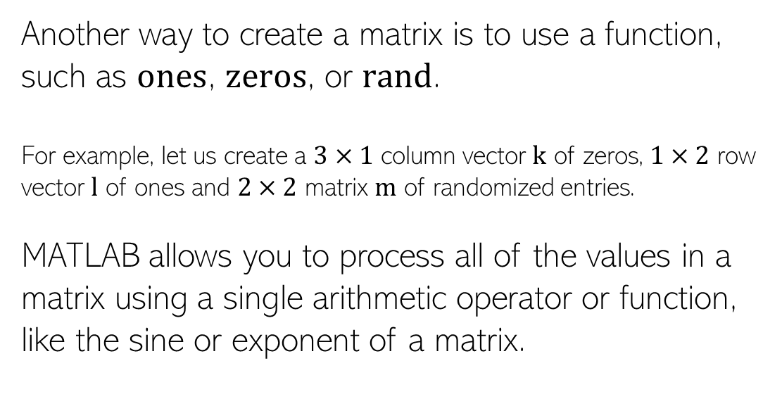
Arrays and Matrices
Another way to create a matrix is to use a function, such as $ones$, $zeros$, or $rand$.
For example, let us create a $3×1$ column vector $k$ of zeros, $1×2$ row vector $l$ of ones and $2×2$ matrix $m$ of randomized entries.
MATLAB allows you to process all of the values in a matrix using a single arithmetic operator or function, like the sine or exponent of a matrix.
MGM
Dr. Mrittunjoy
Guha Majumdar

Slide 14
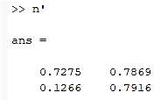
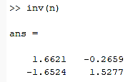
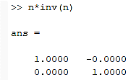
Arrays and Matrices
We can transpose a matrix:
We can find the inverse of a matrix:
MGM
Dr. Mrittunjoy
Guha Majumdar

Slide 15
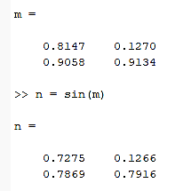
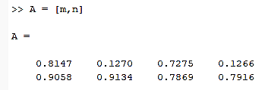
Arrays and Matrices
Concatenation is the process of joining arrays to make larger ones. In fact, you made your first array by concatenating its individual elements. Concatenating arrays next to one another using commas is called horizontal concatenation. Each array must have the same number of rows. Similarly, when the arrays have the same number of columns, you can concatenate vertically using semicolons.
The pair of square brackets [] is the concatenation operator.
MGM
Dr. Mrittunjoy
Guha Majumdar

Slide 16
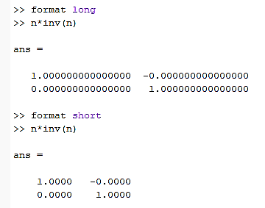
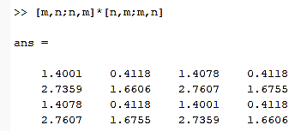
Arrays and Matrices
You can alter the precision and accuracy of the numbers in a matrix by changing the data-type of all data elements.
To perform element-wise multiplication rather than matrix multiplication, use the .* operator.
MGM
Dr. Mrittunjoy
Guha Majumdar

Slide 17
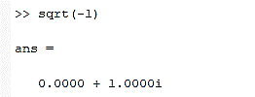
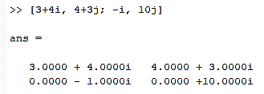
Complex Numbers
We can begin finding the representation of complex numbers with the simple exercise:
To represent the imaginary part of complex numbers, use either $i$ or $j$.
MGM
Dr. Mrittunjoy
Guha Majumdar

Slide 18
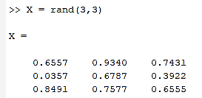

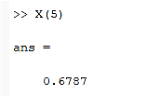
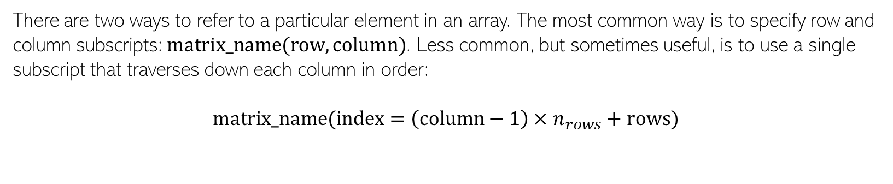
Array Indexing
Let us say we have a randomized matrix $X$:
There are two ways to refer to a particular element in an array. The most common way is to specify row and column subscripts: $matrix_name(row,column)$. Less common, but sometimes useful, is to use a single subscript that traverses down each column in order:
$$matrix_name(index=\left(column−1\right)×n_{rows}+rows)$$
MGM
Dr. Mrittunjoy
Guha Majumdar

Slide 19
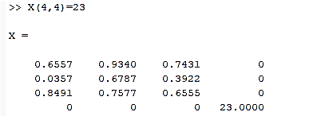
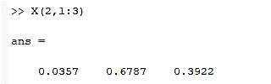
Array Indexing
You can also expand the matrix to accommodate new elements, as in the following example:
To refer to multiple elements of an array, use the colon operator, which allows you to specify a range of the form start:end.
MGM
Dr. Mrittunjoy
Guha Majumdar

Slide 20

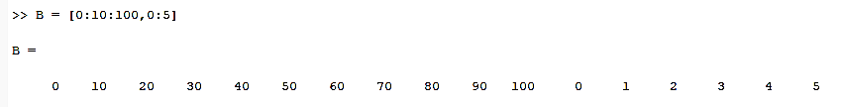

Array Indexing
The colon alone, without start or end values, specifies all of the elements in that dimension.
The colon operator also allows you to create an equally spaced vector of values using the more general form $start:step:end$. If you omit the middle step, as in $start:end$, MATLAB uses the default step value of 1.
MGM
Dr. Mrittunjoy
Guha Majumdar

Slide 21
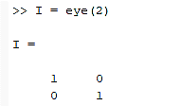
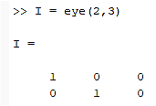
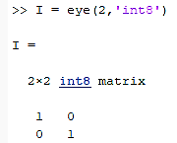

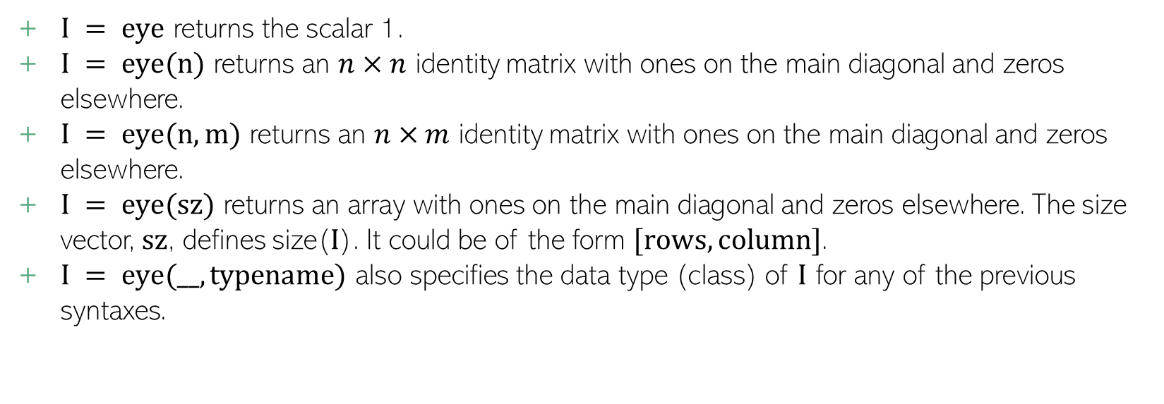
Identity Matrices with $eye$ command
$I = eye$ returns the scalar 1.
$I = eye(n)$ returns an $n×n$ identity matrix with ones on the main diagonal and zeros elsewhere.
$I = eye(n,m)$ returns an $n×m$ identity matrix with ones on the main diagonal and zeros elsewhere.
$I = eye(sz)$ returns an array with ones on the main diagonal and zeros elsewhere. The size vector, $sz$, defines size($I$). It could be of the form $[rows,column]$.
$I = eye(__,typename)$ also specifies the data type (class) of $I$ for any of the previous syntaxes.
MGM
Dr. Mrittunjoy
Guha Majumdar

Slide 22
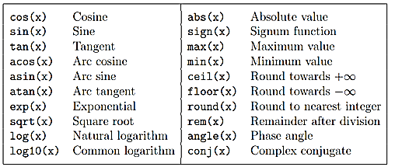
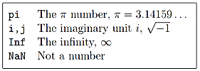
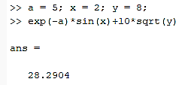
Inbuilt Elementary Functions and Predefined Variables
Illustrative Example:
MGM
Dr. Mrittunjoy
Guha Majumdar

Slide 23
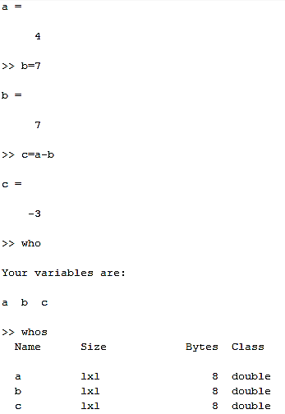

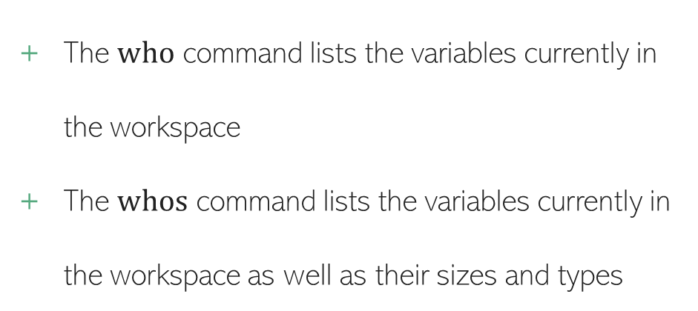
$who$ and $whos$ command
Illustrative Example
The $who$ command lists the variables currently in the workspace
The $whos$ command lists the variables currently in the workspace as well as their sizes and types
MGM
Dr. Mrittunjoy
Guha Majumdar

Slide 24
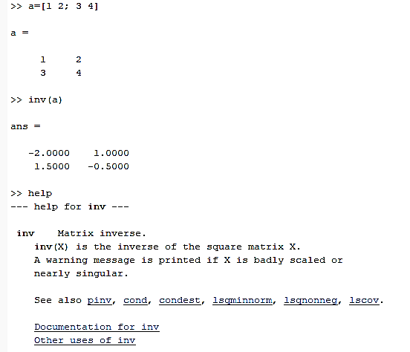
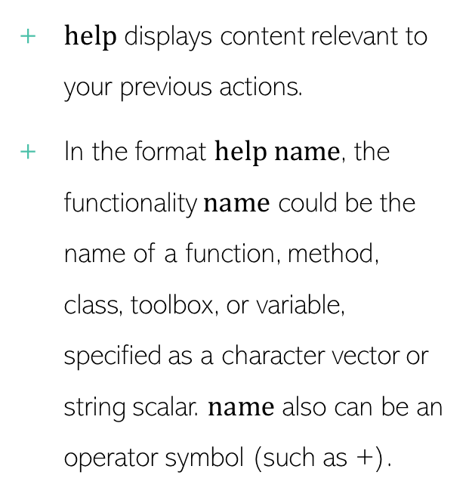

$help$ command
Illustrative Example
$help$ displays content relevant to your previous actions.
In the format $help name$, the functionality $name$ could be the name of a function, method, class, toolbox, or variable, specified as a character vector or string scalar. $name$ also can be an operator symbol (such as +).
MGM
Dr. Mrittunjoy
Guha Majumdar

Slide 25
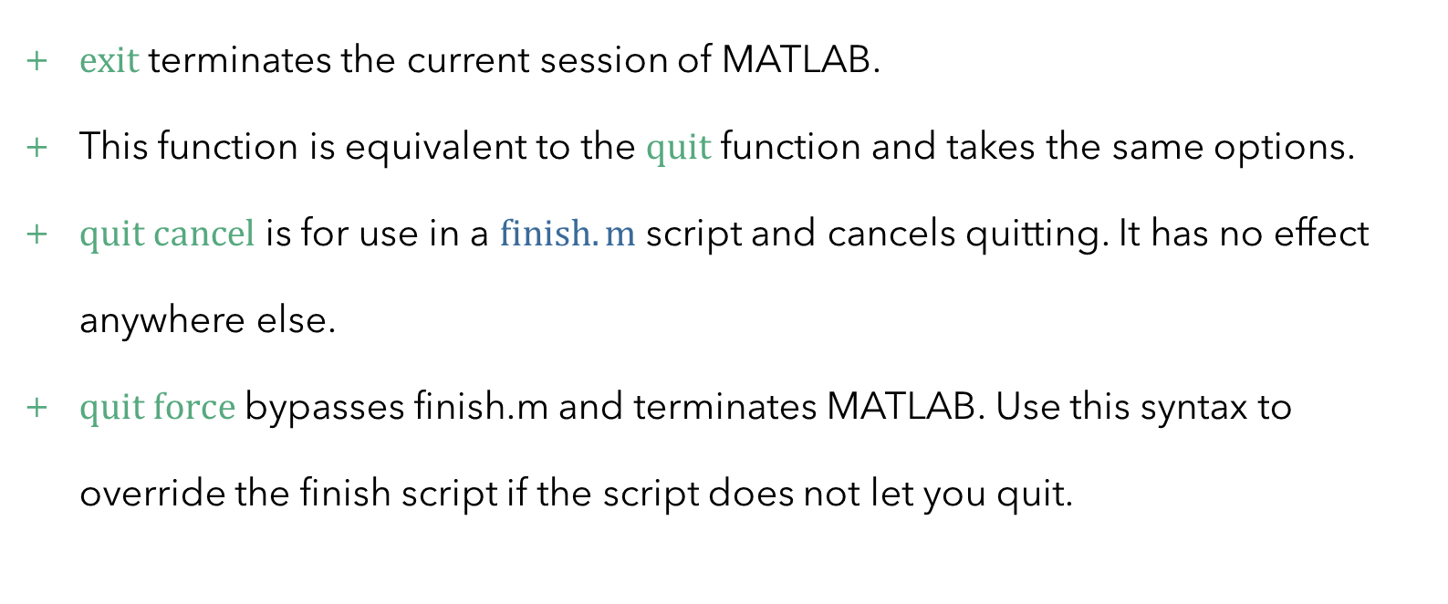

$exit$ and $quit$ command
$exit$ terminates the current session of MATLAB.
This function is equivalent to the $quit$ function and takes the same options.
$quit$ $cancel$ is for use in a $finish.m$ script and cancels quitting. It has no effect anywhere else.
$quit force$ bypasses finish.m and terminates MATLAB. Use this syntax to override the finish script if the script does not let you quit.
MGM
Dr. Mrittunjoy
Guha Majumdar

